Slide 1
The Algorithmic Composition of Classical Music through Data Mining
An All-College Thesis
by
Tom Donald Richmond
Notes:
Music is unique in that, of all major art forms, it has historically relied most upon scientific and mathematical devices in its creation.
The reason behind this can be easily attributed to the notion that music is well founded in the world of mathematics. In fact, the rules of music theory are built upon it.
Both the relations between pitches and durations are best defined by numbers and ratios.
This fact makes it tempting to both analyze and create music through a scientific approach, and it is a venture that has been attempted many times over the course of history
Hi, my name is Tom Richmond from St. John’s University, and with Dr. Imad Rahal, we took our own venture…

Slide 2
Overview
History
Classification
Generation
Discussion
Data
Notes:
During the course of our research, we took our own venture into world of algorithmic composition by means of machine learning.
Over the next twenty minutes, we’ll explore the history that inspired our research
Data used
How we arrived at our selected classification technique,
How we used its statistical model to craft our composition software
Discussion of findings and potential

Slide 3
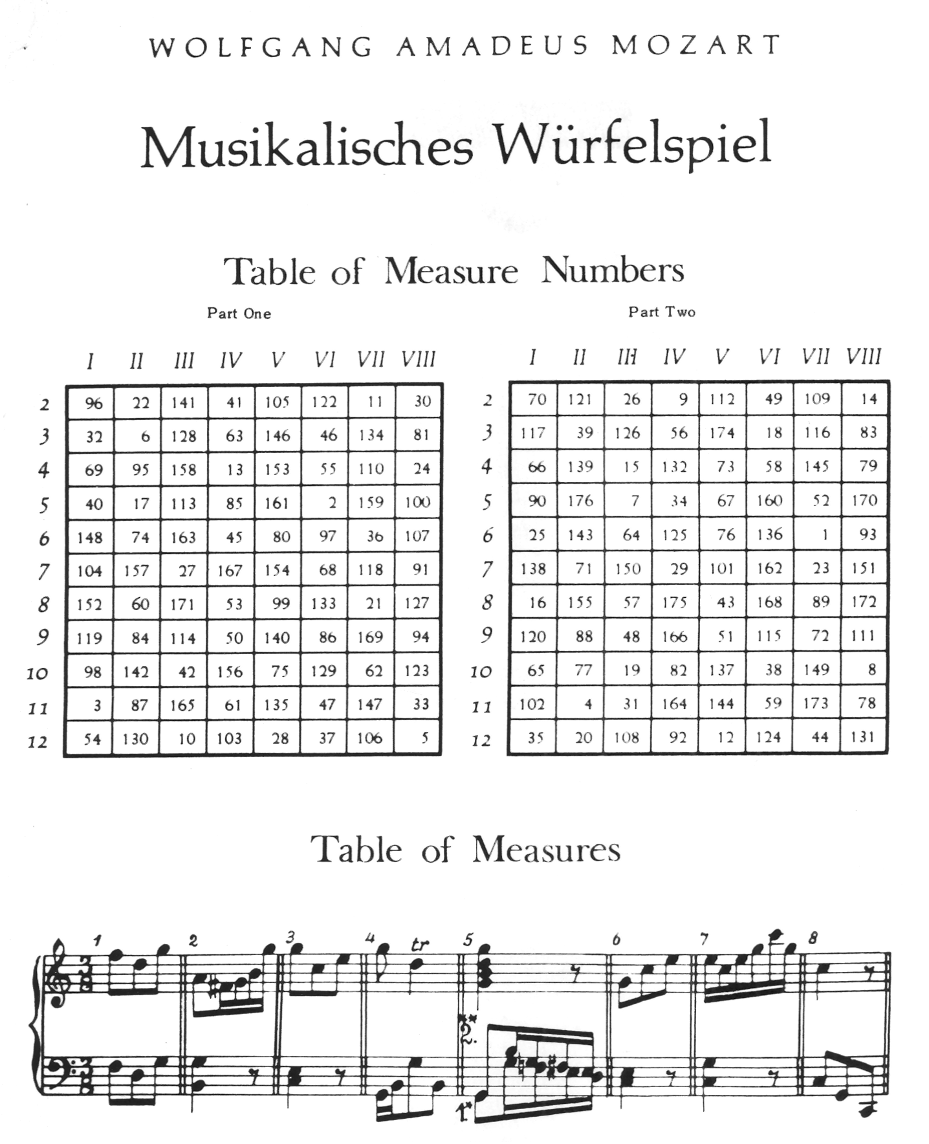
Early Explorations
Music as a discipline of mathematics
Pythagoras and the Music of the Spheres [2] - ~500 BC
Music Theory [5] - 6th Century
Musikalisches Würfelspiel [6] - 18th Century
Notes:
Intersection of math, science and music has a rich history
The groundwork laid as far back as 500 bc
First significant connections drawn between mathematics and music through movements of celestial bodies
It wasn’t until the medieval period that formal rules to govern pitch relations were laid, and music theory was born.
And we saw the very beginnings of algorithmic composition in the 18th century
Allegedly devised by Mozart himself

Slide 4
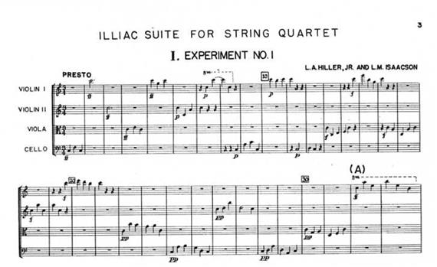
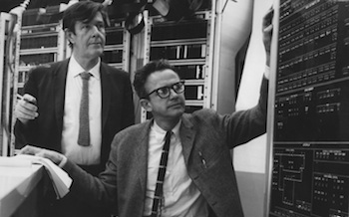
Data Driven Intelligence Era
Illiac Suite [7] – 1958
Markov Chains, stochastic system
Expanded upon by interested parties
Generation
Splinted into groups
Classification
Variety of styles and classes [8], [9]
Notes:
The beginning of the digital age ushered in an intense interest in algorithmic music
It all started in 1958 with Hiller and Isaacson’s Illiac Suite
Based on a Markovian chain model, a stochastic predictive system with a memory of one, the system was able to predict the next note based solely upon the last
Interested parties adapted their work to include an nth order technique
Thereafter, algorithmic composition was splintered into many distinct categories of generation
(6 Gerhard Nierhaus Paradigms of Algorithmic composition: including the likes of generative grammars and transition networks, genetic algorithms, cellular automata, artificial neural networks (ANNs) and artificial intelligence [3])
Computer researchers have also shown much interest in the classification of must, Many successful classification experiments have been conducted based upon a variety of features, and separated into a variety of classes

Slide 5
Hypothesis
Hybridize these concepts
Our proposed approach:
Build a classifier that provides friendly model to be utilized in rule creation in a cellular automata-inspired generative system
Notes:
These experiments were the basis upon which we built the idea of our experiments, with the goal of improving algorithmic composition by utilizing the power of predictive classification methodologies to fuel rule based algorithmic composition techniques
With any venture into data mining, the most important step is to select your data

Slide 6
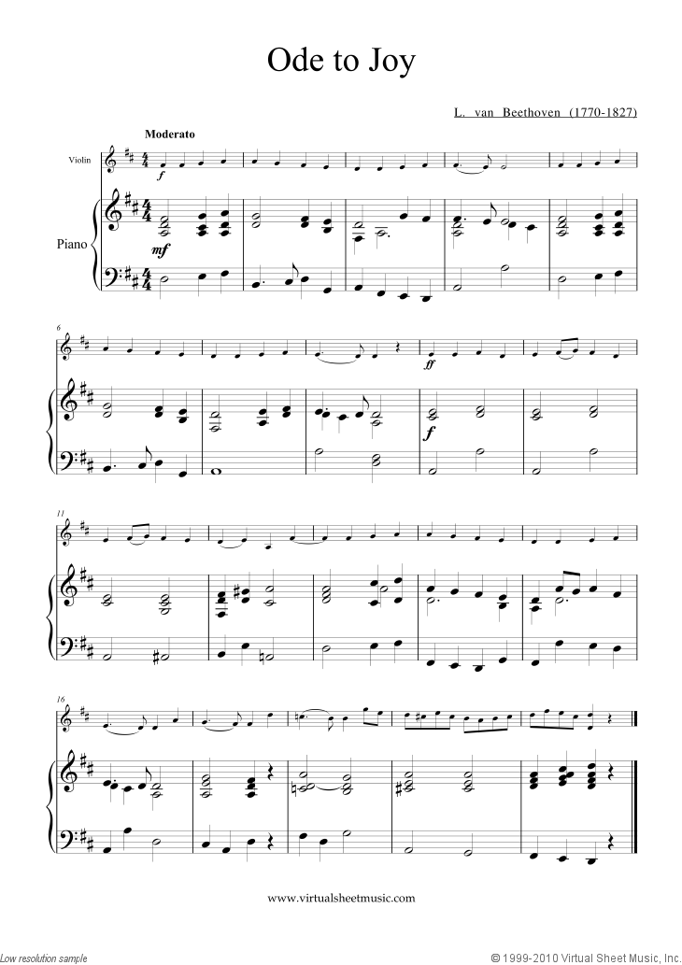
Musical Data
Musical score, or sheet music
Visual representation of music, symbols and key words
9th century monks popularized the practice [10]
Stable backlog of written music across history
Notes:
Luckily for us, there is a large amount of available musical data
For centuries, this data has been recorded by means of musical score or sheet music
Comprised of various symbols and key words that are capable of representing numerous musical features, such as dynamics, durations, pitches, tempo, etc
This idea saw its start in ancient Greek and Middle Eastern civilizations, where they began using basic music symbols as written reminders
9th century monks began practice of recording music by virtue of these symbols on sheets, and the practice exploded

Slide 7
Digital Formats
MIDI
Musical Instrument Digital Interface
Toolkit: jSymbolic
Versatile
Wealth of sources
Humdrum Syntax
Toolkit: Humdrum Toolkit
Specialized
Limited resources
**kern
Notes:
While sheet music is ideal for human use, the dawn of computer music research helped realize the necessity of a new representation of music.
This was due to the visual nature of sheet music, and the challenge that provides a computer to parse it for pertinent information
Two most popular forms of computer-music files for research purposes are MIDI and **kern. For the sake of our experiment, we selected the kern format.
Kern described by creator as “general-purpose software system intended to assist musical research” [12], its textual representation provides us w/ an ideal format for feature extraction

Slide 8
Data Mining
Powerful concept, loose definition
Several ways to accomplish goal
Classification, association, clustering, etc.
Classification
Classes and Attributes
Notes:
The term data mining is rather broad, being defined as “The process of discovering useful information in large data repositories” [13]
This looseness as led to a variety of approaches being developed to accomplish this singular goal
We will be focusing on classification, the task of assigning objects to one of several pre-defined categories or classes based upon a variety of features, or attributes
Trained classifiers are then able to predict the classes of newly introduced pieces of data

Slide 9
Classes and attributes
Classes (Figure 1):
Eras of classical music
6 generally agreed upon by experts [5]
Attributes or Features:
Musical interval frequencies
Figure 1 – Classical Music Eras
Notes:
This makes the task of selecting classes and attributes important to the success of a classifier
For the sake of our experiment, we chose to separate the data into the six distinct classical music eras as classes
In selecting attributes, our musical data presented us with a large number of features to draw upon
We were looking for attributes that benefit both generative process and classification process
For this reason, we zeroed in on the notion of musical intervals, and the frequency at which they appeared during the piece.

Slide 10
Musical Intervals
Based upon chromatic circle (Figure 2)
A musical interval is distance between any two successive pitches within the piece
Defined by ratios
Figure 2 – Chromatic Circle
Notes:
The concept of a musical interval is based upon chromatic circle, an equal temperament, cyclical scale, which makes up the backbone of western music
Between any two adjacent pitches on circle is half a step (reference circle)
An octave is the distance between identical notes after a single cycle. This interval has a 2:1 hertz ratio, thus 440hz, 220hz and 110hz all signify the pitch ‘A’

Slide 11
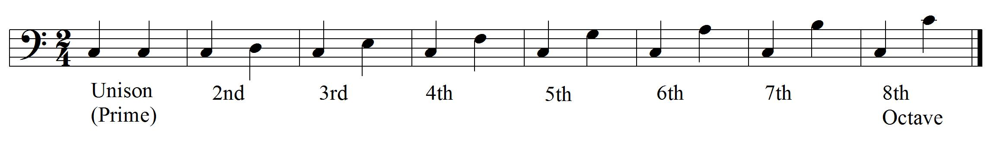
MORE ON INTERVALS
 | Attribute | Description
X₁ | freqUni | Ratio at which unison intervals occur (unison/total)
X₂ | freqStep | Ratio at which stepwise intervals occur (step/total)
X₃ | freqThird | Ratio at which third intervals occur (third/total)
X₄ | freqFourth | Ratio at which fourth intervals occur (fourth/total)
X₅ | freqFifth | Ratio at which fifth intervals occur (fifth/total)
X₆ | freqSixth | Ratio at which sixth intervals occur (sixth/total)
X₇ | freqSeventh | Ratio at which seventh intervals occur (seventh/total)
X₈ | freqOct | Ratio at which octave intervals occur (octave/total)
Range from unison to octave (Figure 4)
Dual functionality
Identifying feature in aural skills [16]
Excellent building block
Figure 3 – Selected features
Figure 4 – Various musical intervals as represented on musical score
Notes:
From this scale, we can derive a ratio between any two successive notes
Our features range from unison, meaning there is no distance between the two pitches, to the octave.
The reason for the selection of these features was twofold
It presents us with an identifying feature of music, which is often cited in aural listening skills when distinguishing between eras
It also provides us with features which can be imitated and used as an excellent building block for our generative process.

Slide 12
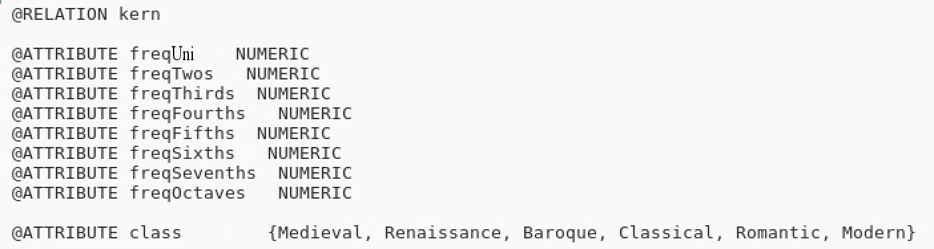
Pre-Processing
262 **kern scores (Figure 5)
Musical intervals extracted via command line
Each frequency appended to Attribute-Related File Format (.arff) file, along with class (Figure 6)
Class | Number of Data Entries
Medieval | 10
Renaissance | 26
Baroque | 77
Classical | 50
Romantic | 70
Modern | 29
Total | 262
Figure 5 – Data Distribution by Class
Figure 6 – ARFF Header
Notes:
We were able to find 262 unique **kern scores from the medieval through modern eras for our experiment. It is worth noting that the data is not evenly distributed, as some eras have withstood the test of time better than others, and have more available data.
Using the humdrum toolkit and pattern matching in a linux command line, we were able to extract the number of occurrences of each interval, and divide it by the total number of intervals.
We appended these frequencies to a single arff file, along with the class it is associated with

Slide 13
Classifiers
Naïve Bayes
Multilayered Perceptron (ANN)
Logistic Regression
Decision Tree (J48)
Rule Based (JRip)
Notes:
Using this arff file, we began our classification.
There were countless techniques that fit the classification schema to choose from
These five techniques selected for the sake of their diversity, ranging greatly in both complexity and output.

Slide 14
Results
N-Fold Cross Validation (10 iterations)
Success based on AUC (area under the curve) of a Receiver Operating Characteristic graph
Naïve Bayes selected based on statistical model and excellent AUC values
 | Medieval | Renaissance | Baroque | Classical | Romantic | Modern | Average
MLP | 0.964 | 0.958 | 0.854 | 0.988 | 0.836 | 0.996 | 0.933
LR | 0.981 | 0.951 | 0.808 | 0.921 | 0.885 | 0.927 | 0.885
Naïve | 0.938 | 0.931 | 0.73 | 0.889 | 0.853 | 0.871 | 0.838
JRip | 0.705 | 0.841 | 0.73 | 0.874 | 0.704 | 0.836 | 0.773
J48 | 0.798 | 0.777 | 0.681 | 0.804 | 0.741 | 0.753 | 0.753
Figure 7 – Results of classifier
Notes:
9/10ths used as training set, 1/10th as test set. Reiterated ten times over
The Receiver Operating Characteristic (ROC) Curve maps the True Positive Rate (true positives / all positives) against the False Positive Rate (false positives / all negatives).
This produces a curve that will represent how often a piece is mistakenly identified as other than its proper class, rather than produce a true precision rate, which may be skewed as a result of the uneven distribution of data.
A perfectly classified set of data would have an AUC of 1.
As you can see, the chosen classifiers performed admirably, ranging from .933 to .753 AUC values
In the end, we selected Naïve bayes by virtue of its statistical model, and its high AUC of .838.

Slide 15
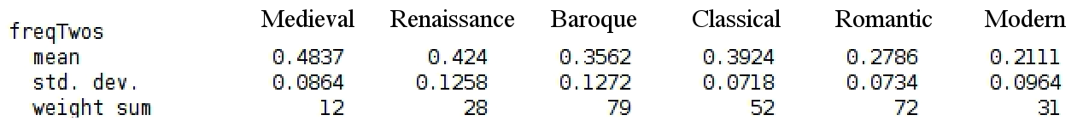
Generation
Challenge:
Based upon model provided by Naïve Bayes (Figure 8), build a generation technique
Statistically inspire cellular automata progression
Figure 8 – Naïve Bayes sample output
Notes:
With our classification process completed, our next challenge was to build a generative process.
We decided the concept of cellular automata presented us with a nice opportunity to use the statistical output of Naïve bayes to inspire its generation

Slide 16
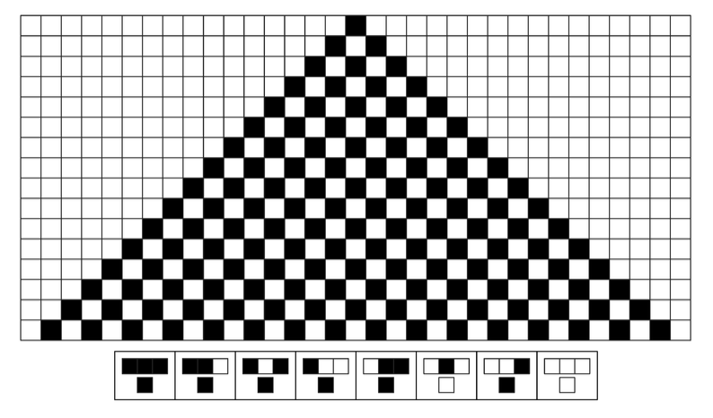
Cellular Automata
Grid of cells, each containing one of a finite number of states
Cell state shifts based transitionary rules
Shift dictated by predetermined ‘neighborhood’ of cells
Wolfram Algorithm (Figure 9) [18]
Figure 9 – Wolfram Elementary Algorithm Rule 250
Notes:
Cellular Automata, based upon the cellular replication process.
Devised by John von Neumann (50s), it has been utilized by some of the biggest names in math and computing, including Stephen Wolfram and John Horton Conway
A cellular automata is comprised of a grid of cells, each of which being one of a finite number of state. With each step in time, each cell shifts states based on the state of surrounded cells known as a neighborhood
This concept has been used in basic music composition as a way to create chaos and patterns within music

Slide 17
Proposed Musical Model
Each cell has one of two states: ‘ON’ or ‘OFF’
Binary interpretation of cell sequence mapped to note values (Figure 10)
Four-cell wide grid (16 values)
Transitionary rules determine the most likely interval from the previous four-cell sequence to the next based upon Naïve Bayes output
Figure 10 – Binary Mapping of Chromatic Scale
Notes:
With this model as a framework, we shift focus to our most contributory work
Using binary states of ‘on and off’, it is possible to represent each individual note with a four byte sequence, represented by four automata cells
The transitionary rules of our automata were then created based upon the aforementioned statistics provided by the classifier.
These transitionary rules can be adjusted depending on the desired replicated era
For example, a four cell grid with on, off, on, off maps to a note value of ‘A’

Slide 18
Example
Selected Era: Medieval
Previous Note Sequence: C, or 0001
Random Number Output: 0.619749892376492
New note sequence is therefore a D, 1100
Interval | Mean Frequency
Unison | 0.1484
Step | 0.4998
Third | 0.1178
Fourth | 0.0371
Fifth | 0.0234
Sixth | 0.004
Seventh | 0.0014
Octave | 0.0057
.6197
Figure 11 – Mean values for medieval intervals

Slide 19
Results
Automated Composition Software
Able to imitate one of six classical eras
Linearly produces notes based upon interval from last note
MIDI output
Limitations
Rhythm
Dynamics
Figure 12 – Our composition software
Notes:
The fruit of our labour is an automated composition software capable of imitating one of six classical music eras.
The system progresses linearly, one note per 750 ms, and the pitch is outputted via a MIDI feature in java.
Currently, the system has a number of limitations, including the lack of rhythm and dynamic consideration.

Slide 20
Analysis
Machine evaluation (Figure 13)
Composed 60 scores of 100 notes, 10 from each respective era
Used as test set to previous training set with previous classifiers
Tests performed admirably next to results of original classification process
Expert evaluation
Composed three 10-second clips from each era
Presented to five scholars of music with a variety of experiential backgrounds
 | Medieval | Renaissance | Baroque | Classical | Romantic | Modern | Average
MLP | 0.942 | 0.9 | 0.858 | 0.918 | 0.754 | 0.986 | 0.893
LR | 0.978 | 0.938 | 0.824 | 0.946 | 0.836 | 0.998 | 0.92
JRip | 0.852 | 0.753 | 0.662 | 0.816 | 0.582 | 0.786 | 0.742
J48 | 0.812 | 0.757 | 0.757 | 0.8 | 0.678 | 0.826 | 0.772
Figure 13 – Results of our machine evaluation
Notes:
In an attempt to analyze our results, we took a machine evaluation approach
We composed ten scores from each era, each with the length of 100 notes. We fed these compositions as a test set into the classifiers from earlier, excluding our chosen naïve bayes classifier, and results were almost identical to the ability of our classifiers to identify traditionally composed music
As you can see, results were encouraging, and indicate that our generative process was successful in replicating the desired musical features

Slide 21
Discussion
Conclusion
**kern
Classifiers
Classes: Musical Eras
Features: Musical Intervals
Cellular Automata
Future Works
Hybridize for other features
N^{th}-Order
Notes:
No surprise that indirect vs direct yielded a tale of two stories.
Features like instrumentation, rhythm, harmony
Future of algorithmic composition is wide open
At the end of the day, our system shows potential to be expanded upon. Further hybridization could lead to the inclusion of features such as rhythm, harmony and instrumentation.
The importance of such features were stressed during and attempt we made at human evaluation of, when studied musicians indicated that the lack of such features makes it hard to aurally determine a pieces era.
There is also the potential of implementing an nth order technique to improve note prediction. Our cellular automata model offers a highly adaptable composition software, and its expansion is wide open.

Slide 22
References
[1] P.P. Wiener, Dictionary of the History of Ideas. Studies of Selected Pivotal Ideas. III, Chales Scribner's, 1973.
[2] A. Boethius, “Fundamentals of Music,” in Strunk’s Source Readings in Music History, ed. O. Strun, 1998.
[3] G. Niederhaus, Algorithmic Composition: Paradigms of Automated Music Generation. Vienna, Austria: Springer-Verlag, 2009.
[4] G. Diaz-Jerez, Algorithmic Music: Using Mathematical Models in Music Composition. The Manhattan School of Music, 2000.
[5] V. Duckles, et al, Musicology. Grove Music Online, 2001.
[6] J.D. Fernandez and F. Vico, "AI Methods in Algorithmic Composition: A Comprehensive Survey," Journal of Artificial Intelligence Research., vol. 48, pp. 513-582, 2013.
[7] L.A. Hiller and L.M. Isaacson, “Musical composition with a High-Speed digital computer”. Journal of the Audio Engineering Society, 6 (3), pp. 154–160, 1958.
[8] J. Lebar, et al., ‘Classifying Musical Scores by Composer’, Stanford University, 2008.
[9] R. Basili, et al., ‘Classification of Musical Genre: A Machine Learning Approach’, University of Rome Tor Vergata, 2004.

Slide 23
References
[10] N. Tawa, Sheet Music. Grove Music Online, 2014.
[11] C. Anderton, ‘Craig Anderton’s Brief History of MIDI’, 2014. [Online]. Available: https://www.midi.org/articles/a-brief-history-of-midi. [Accessed: 01- Mar- 2018].
[12] D. Huron, “The Humdrum User Guide”, 1999.
[13] P. Tan, et al. An Introduction to Data Mining. Pearson Nueva Delhi (India). 2016.
[14] S.C. Suh, Practical Applications of Data Mining. Texas A&M University. Jones & Bartlett Learning, 2012.
[15] R. Hall, ‘Intervals and Pitches’ in Sounding Number: Music and Mathematics from Ancient to Modern Times, 2017.
[16] J. James, “Identifying and presenting eras of classical music”, from Music Teacher, 2017.
[17] T.M. Li, “Cellular Automata”, New York: Nova Science Publishers, Inc., 2011.
[18] S. Wolfram, “A New Kind of Science”, Champaign: Wolfram Media, Inc., 2002.

